Slide 1
Development of a Pan-Tilt Gimbal Control System for Mechanical Video Stabilization and Vision Based Target Tracking
Batch No. MHRP07
Project Members
Sharish K A (RA2211038010017)
Diyanez Kandasaamy J S (RA2211038010032)
Anirudh A (RA2211038010049)
Under the Guidance of
Dr. R. Senthilnathan M.E., Ph.D.

Slide 2
Introduction
This project aims to develop a pan-tilt gimbal system for mechanical video stabilization and target tracking. The objective is to design a control system for an existing gimbal platform that is both robust against disturbances as well as agile and stable during object tracking.
The system utilizes a mechanically balanced pan-tilt mechanism to counteract external disturbances typically originating from movements from vehicle traversing undulated road surfaces on which the gimbal shall be mounted.
The performance of the system will be assessed in broadly two aspects namely: Stabilization and Vision based Tracking performance.

Slide 3
Objective
Integrate an existing pan tilt gimbal comprising onboard sensors and actuators to a FPGA based real-time controller.
To develop a pan-tilt gimbal control algorithm for mechanical stabilization, that reduces the effect disturbances, both internal and external, on the camera.
To develop an agile tracking system that enables the gimbal to lock onto the target specified by the user and follow it, maintaining minimum tracking error under dynamic conditions.
21MHP401L/403L - Major Project

Slide 4
Tasks achieved
To complete a literature survey on the control and tracking algorithms deployed in our project
To complete a MATLAB simulation on resolver circuit and implemented a test controller
To perform a benchmark of a Laplacian filter on an image on both FPGA and ARM processor and compare their average latency using VIVADO and VITIS HLS.
To complete CAD designs and fabrication of camera, sensor mounts.
21MHP401L/403L - Major Project

Slide 5
S.No | Title of the Paper | Authors | Journal Name & year | Remarks
1 | Real-Time Adaptive Target Tracking via Inverse Kinematics Optimization in Stabilized Systems | Abderahman Kriouile, Soufiane Hamida Oussama, El Gannour and Abdoul Latif Abdou Moussa | IEEE, 19 August 2025 | Adopting Inverse Kinematic optimization to reduce latency and improve the accuracy in real-time
2 | Discriminative Correlation Filter Tracker with Channel and Spatial Reliability | Alan Lukežič, Tomas Vojíř, Luka Čehovin Zajc, Jiří Matas and Matej Kristan | International Journal of Computer Vision, 14 Jan 2019 | Reference for implementing spatial reliability in tracking algorithms
3 | Modeling and Control of a Two-Axis Stabilized Gimbal Based on Kane Method | Qixuan Huang, Jiaxing Zhou, Xiang Chen, Youxin Yao, Yuhao Chen, Wei Chen Runjing Chen and Zhisheng Lv | Sensors, 3 June 2024 | Utilizing the Kane Method for dynamic modeling to simplify the complex equations of motion
4 | Robust Control of a Two-Axis Gimbaled Seeker Using Loop Shaping Design Procedure | Ho Pyeong Lee | IEEE, 18 July 2019 | Implementing a Loop Shaping design procedure to ensure robust performance and stability
5 | The Stabilization Loop Design for a Two-Axis Gimbal System Using LQG/LTR Controller | Ki-Jun Seong, Ho-Gyun Kang, Bo-Yeon Yeol, and Ho-Pyeong Lee | IEEE, 18 Oct 2006 | Adopting the LQG/LTR controller framework for the stabilization loop

Slide 6
Components required with Price details
S.No | Component Name | Specification | Price /piece (INR) | Quantity required | Total Cost (INR)
1. | Pynq Z2 | Dual-Core ARM cortex A9, DDR3 512MB | - | 1 | -
2. | Limit Switches |  |  | 4 | -
3. | Optical limit switches |  | 85 | 4 | 340
4. | MOSFET Driver | 4.5-18V 1.5A | 132 | 2 | 264
5. | PLA Filament | 1Kg, White | 940 | 1 | 940
6. | Operational Amplifier | LM324N | 13 | 2 | 26
7. | Kollmorgen Motor | QT1903 | - | 2 | -

Slide 7
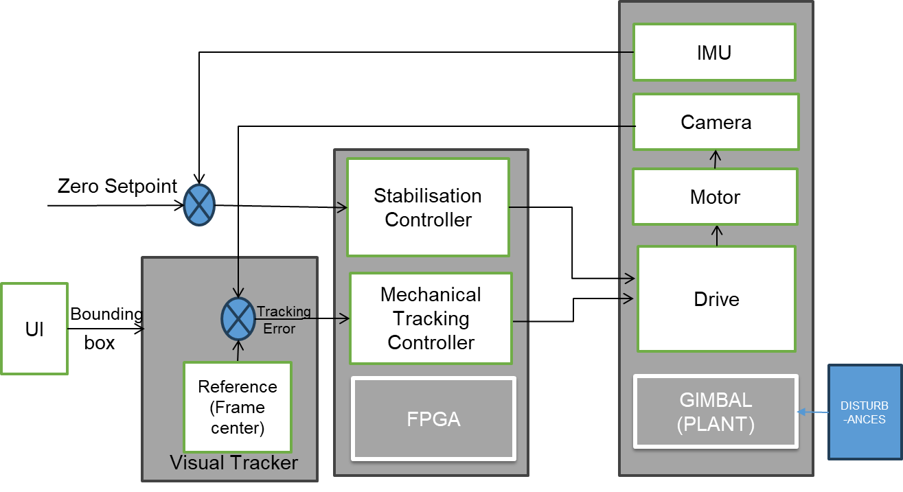
Methodology
21MHP401L/403L - Major Project

Slide 8
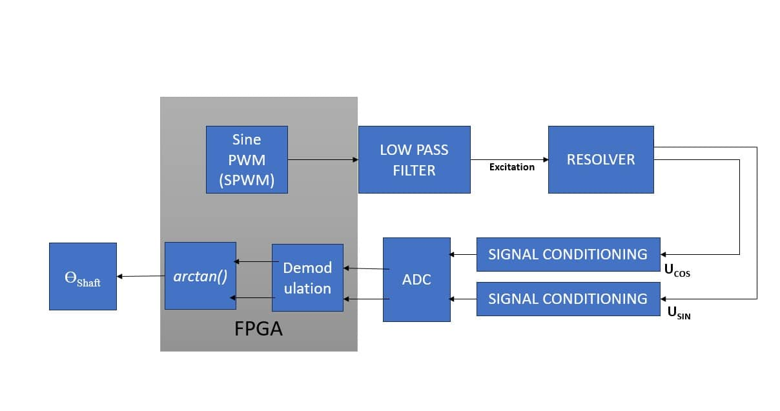
Progress after zeroth review
Resolver Methodology
21MHP401L/403L - Major Project

Slide 9
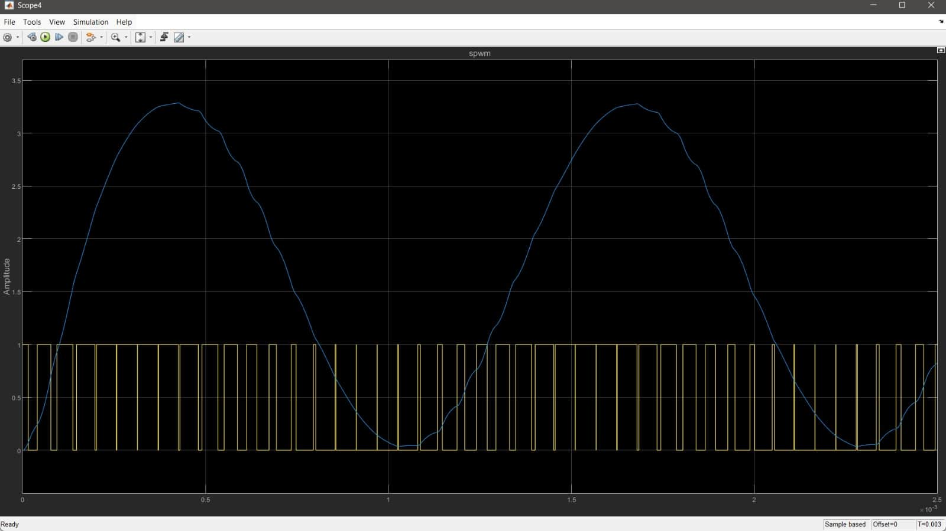
SPWM
21MHP401L/403L - Major Project

Slide 10
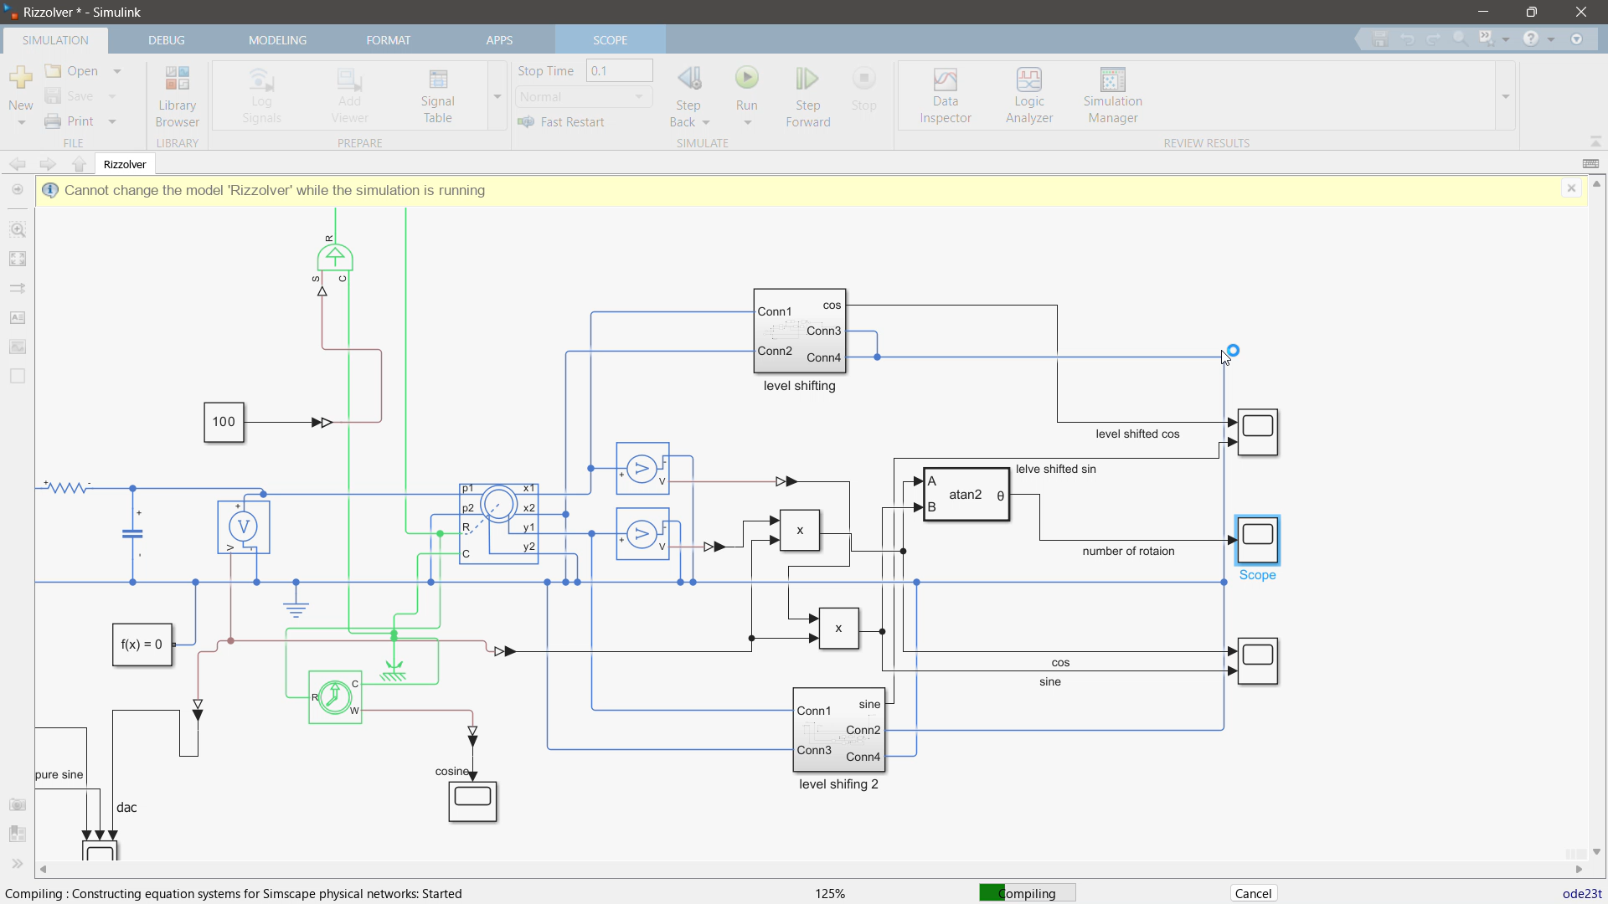
Demonstration
21MHP401L/403L - Major Project

Slide 11
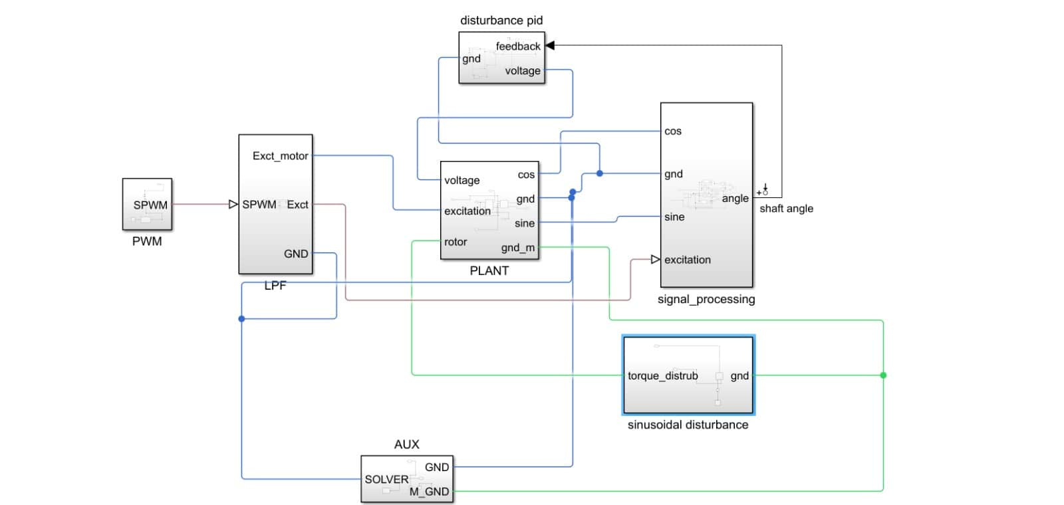
Disturbance rejection control
21MHP401L/403L - Major Project

Slide 12
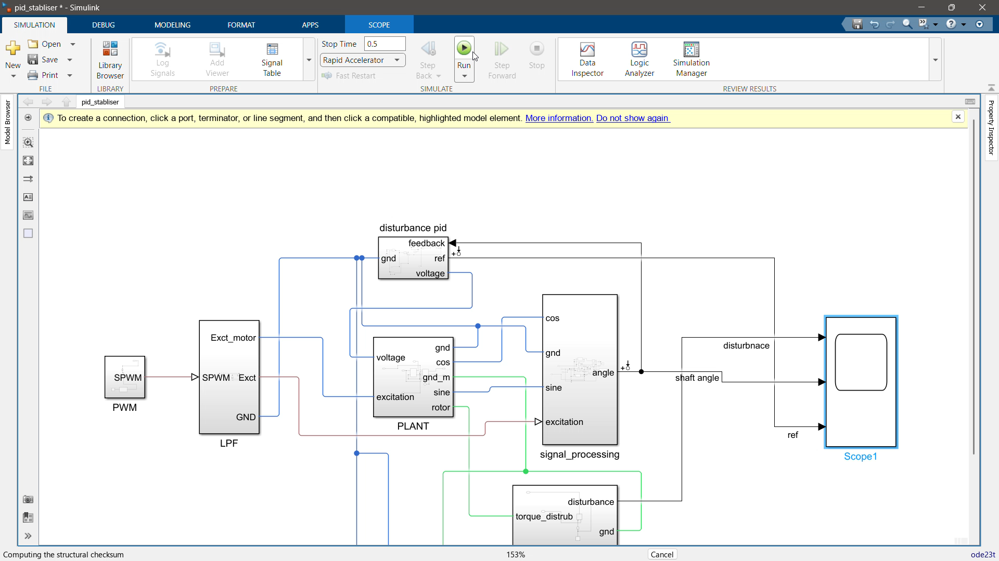
Disturbance rejection demo
21MHP401L/403L - Major Project

Slide 13
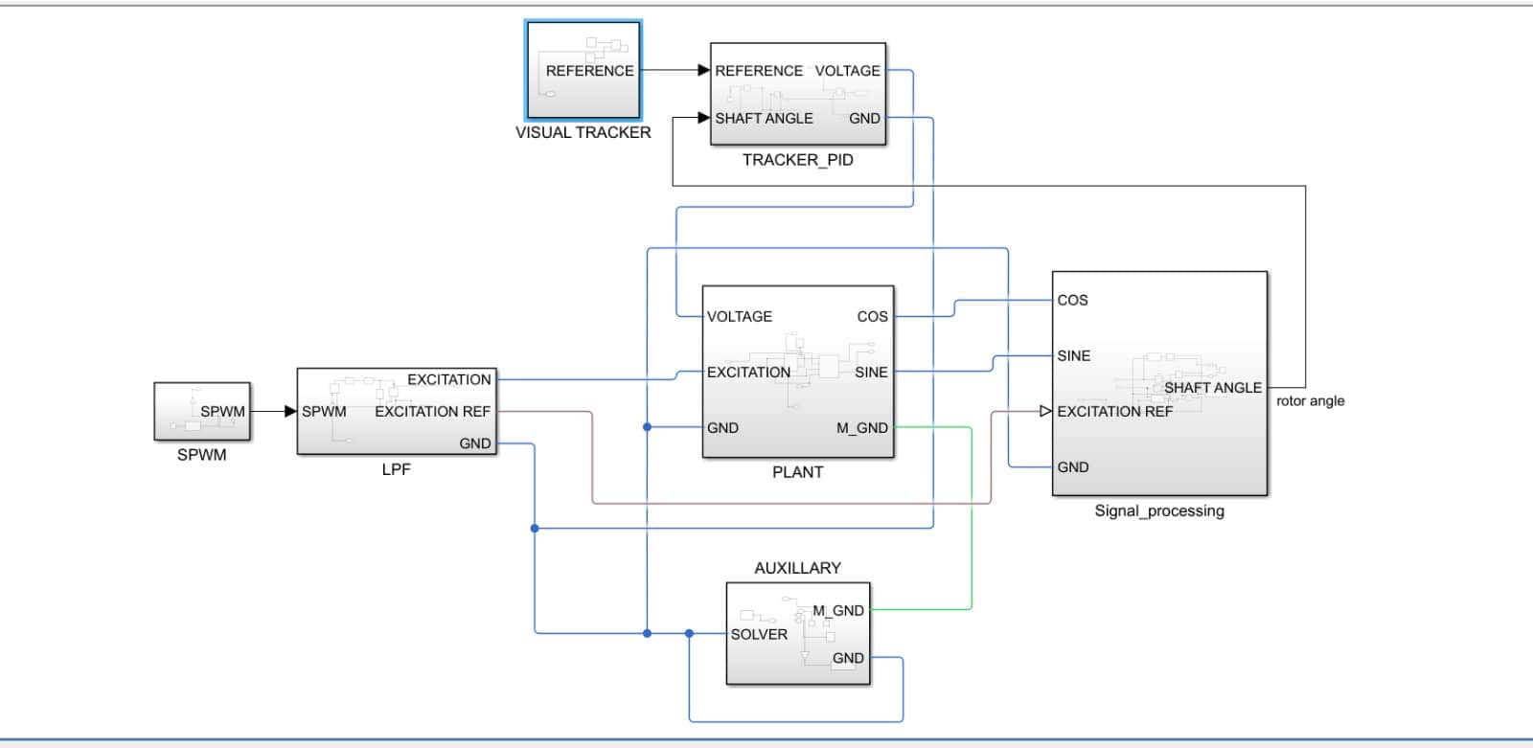
Tracking controller
21MHP401L/403L - Major Project

Slide 14
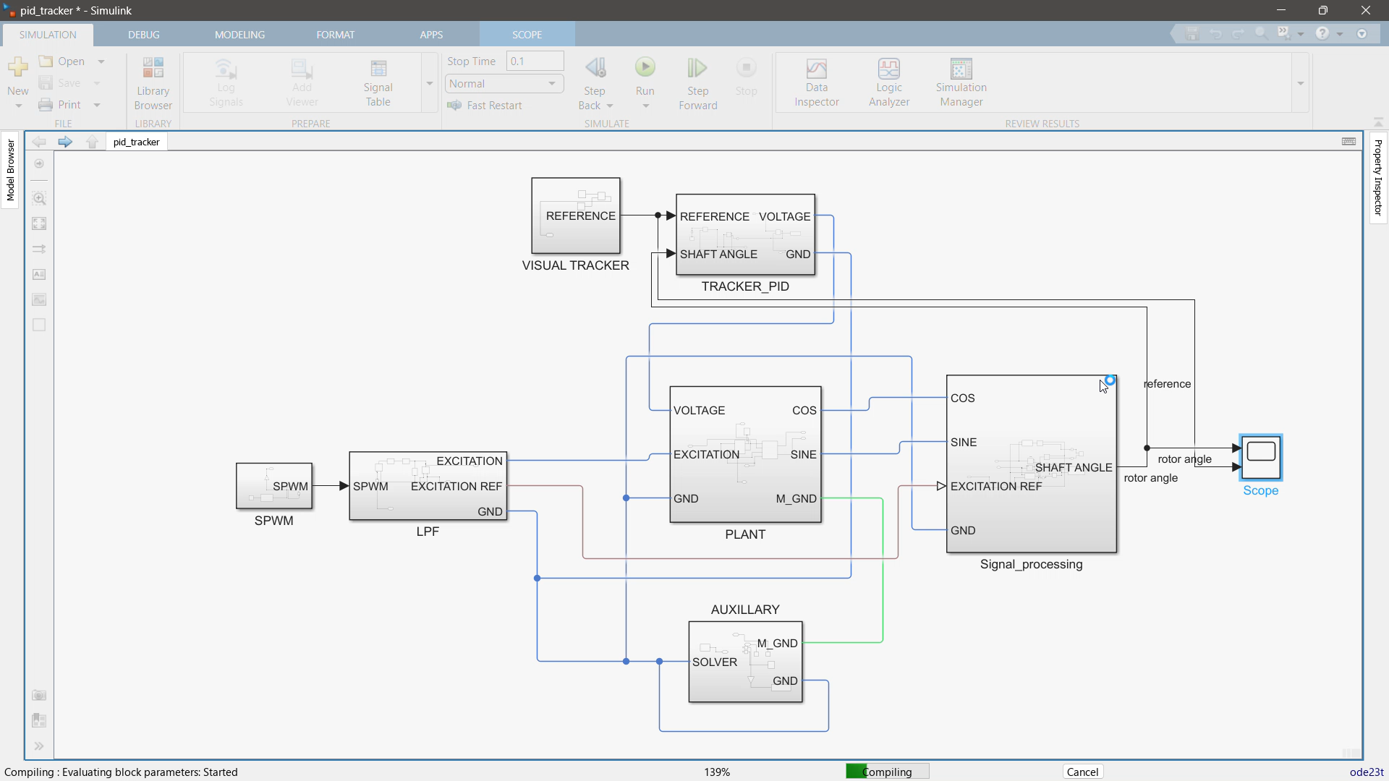
Visual tracker demo

Slide 15
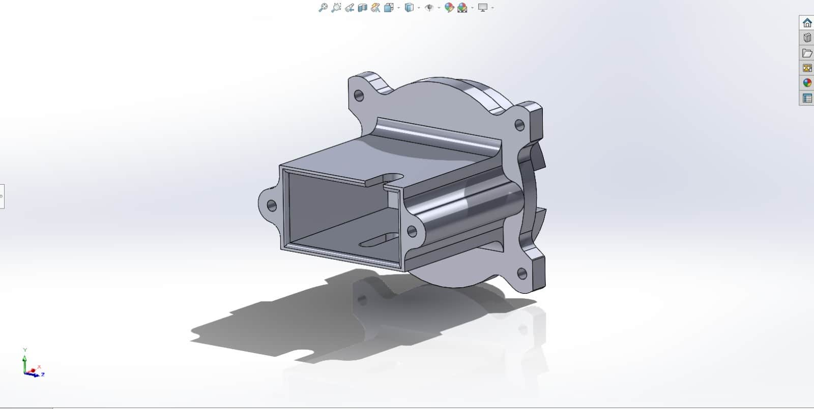
Camera Mount CAD (PART 1)

Slide 16
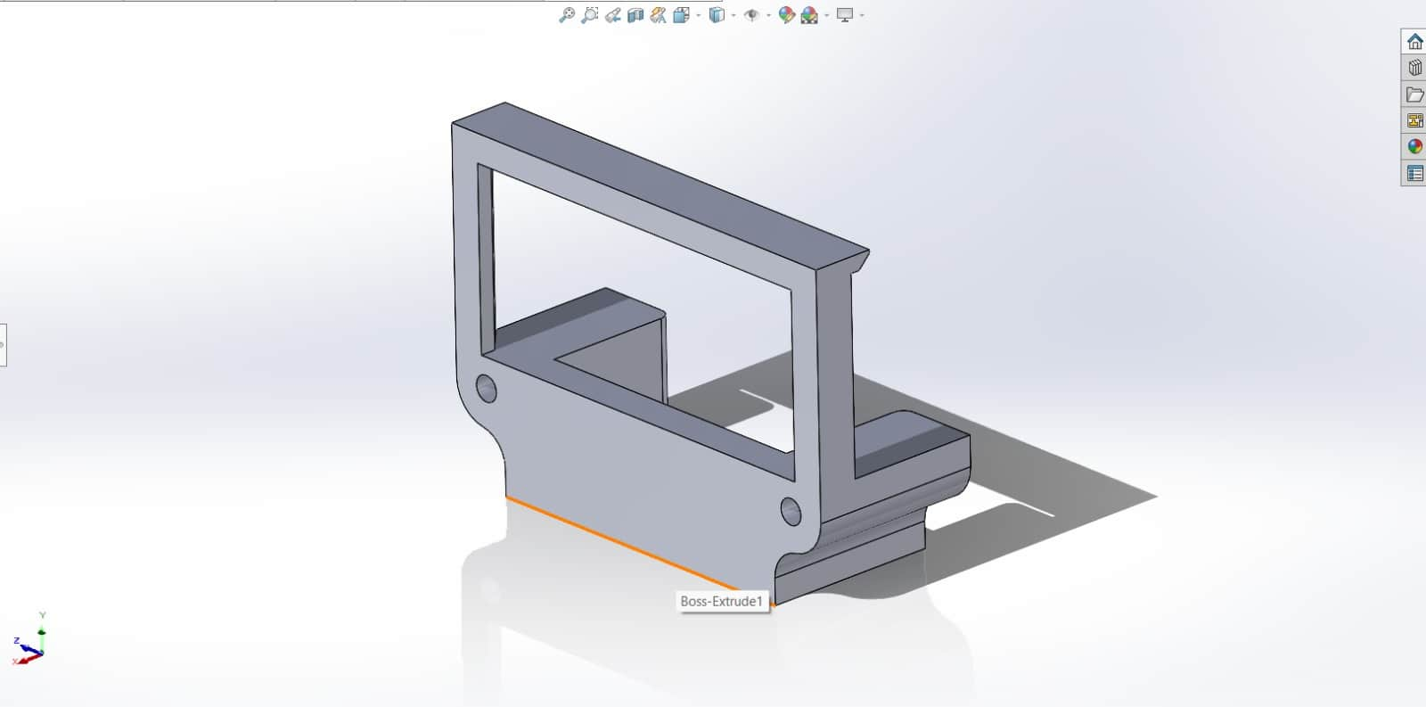
Camera Mount CAD (PART 2)

Slide 17
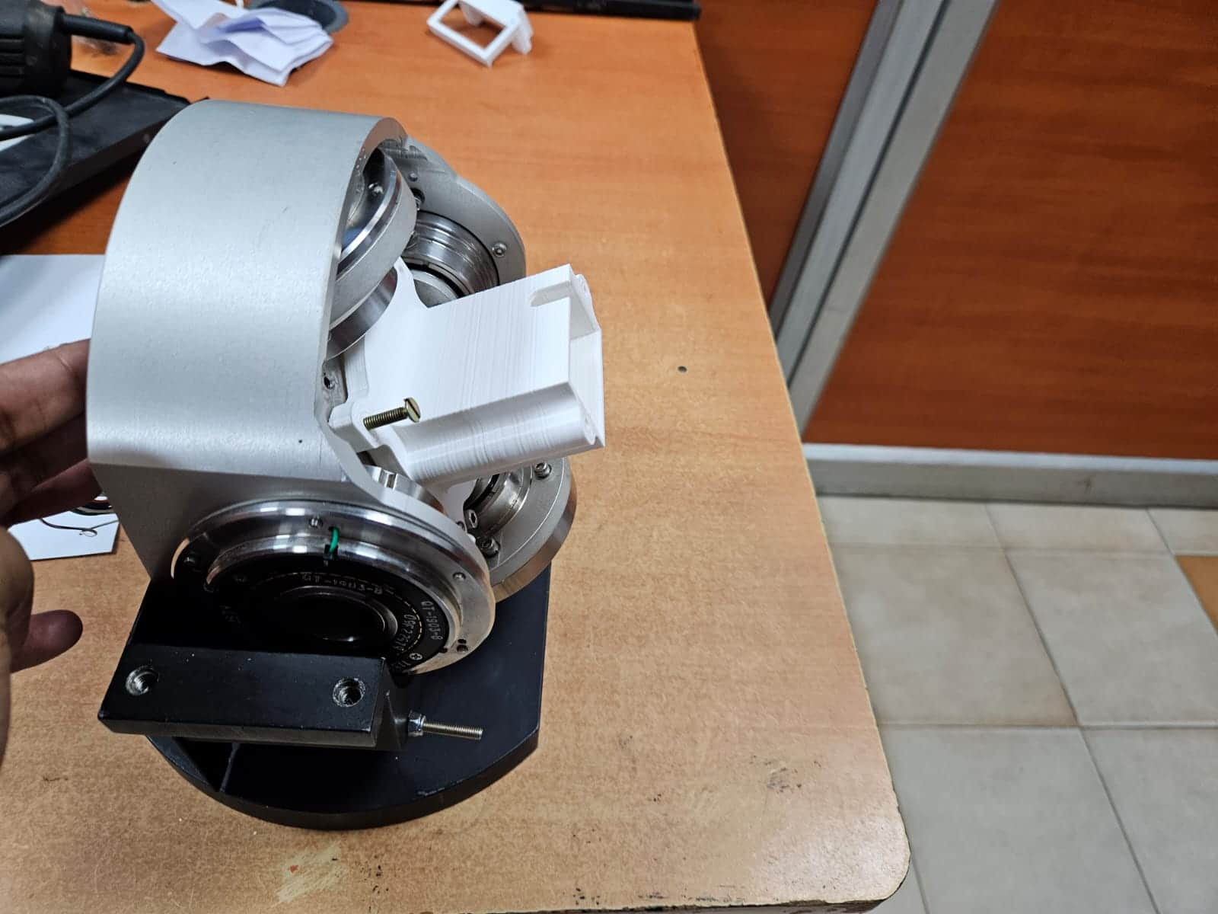
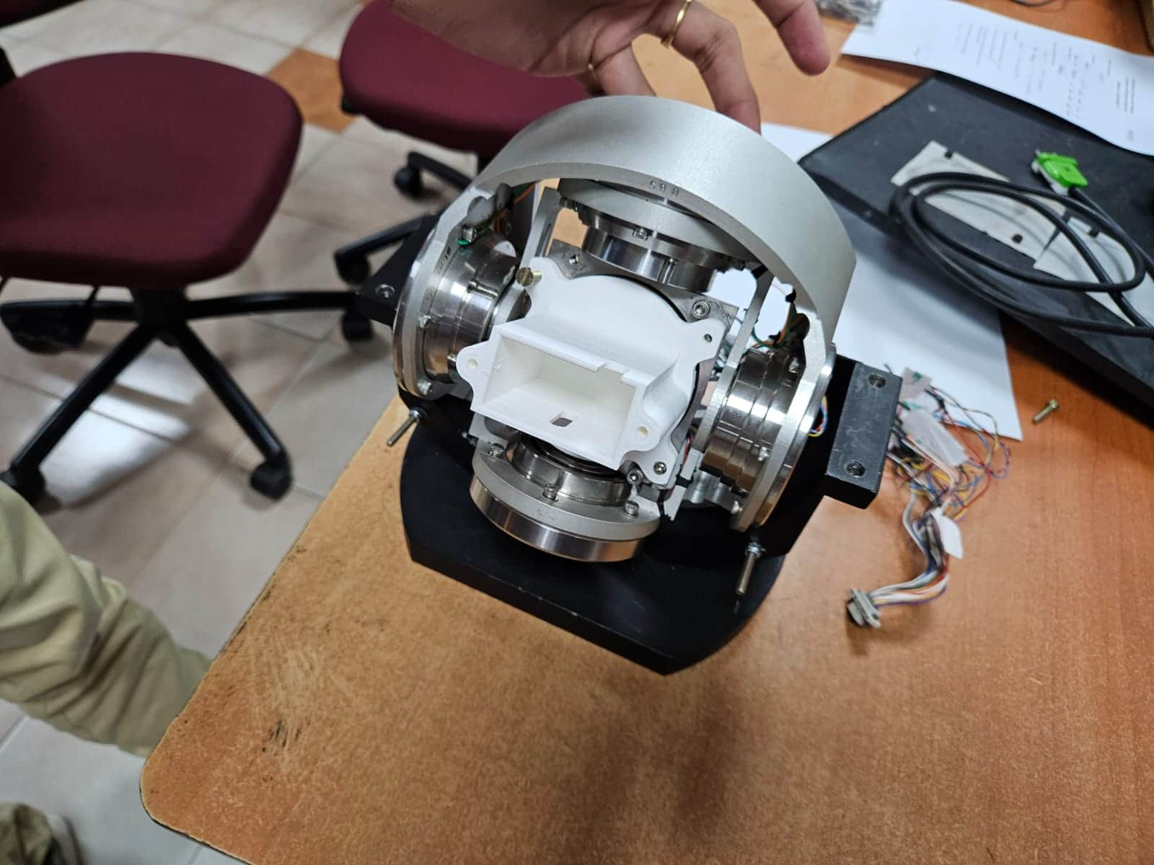

Slide 18
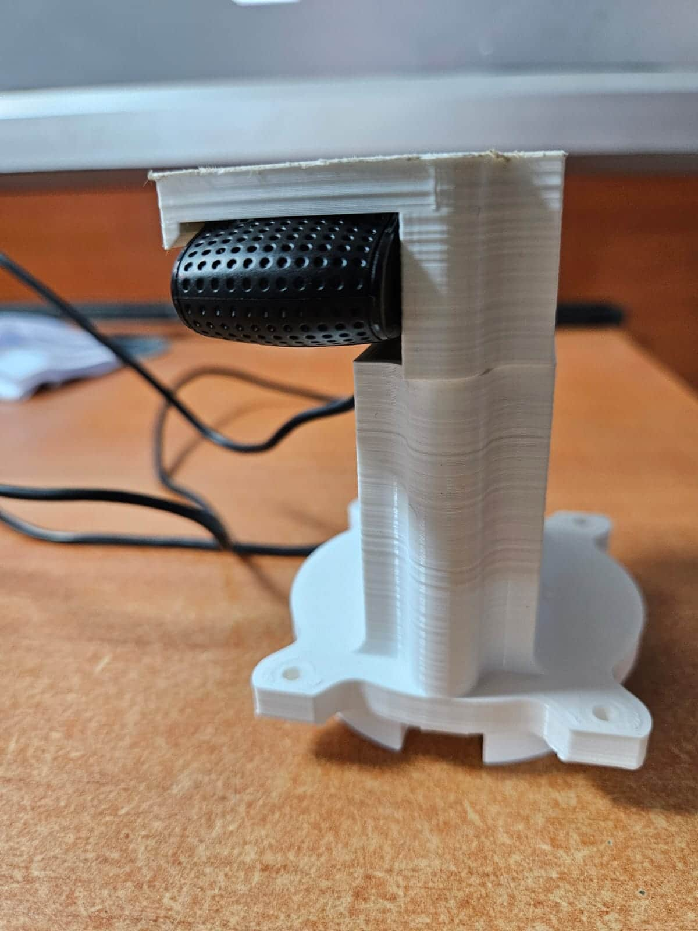
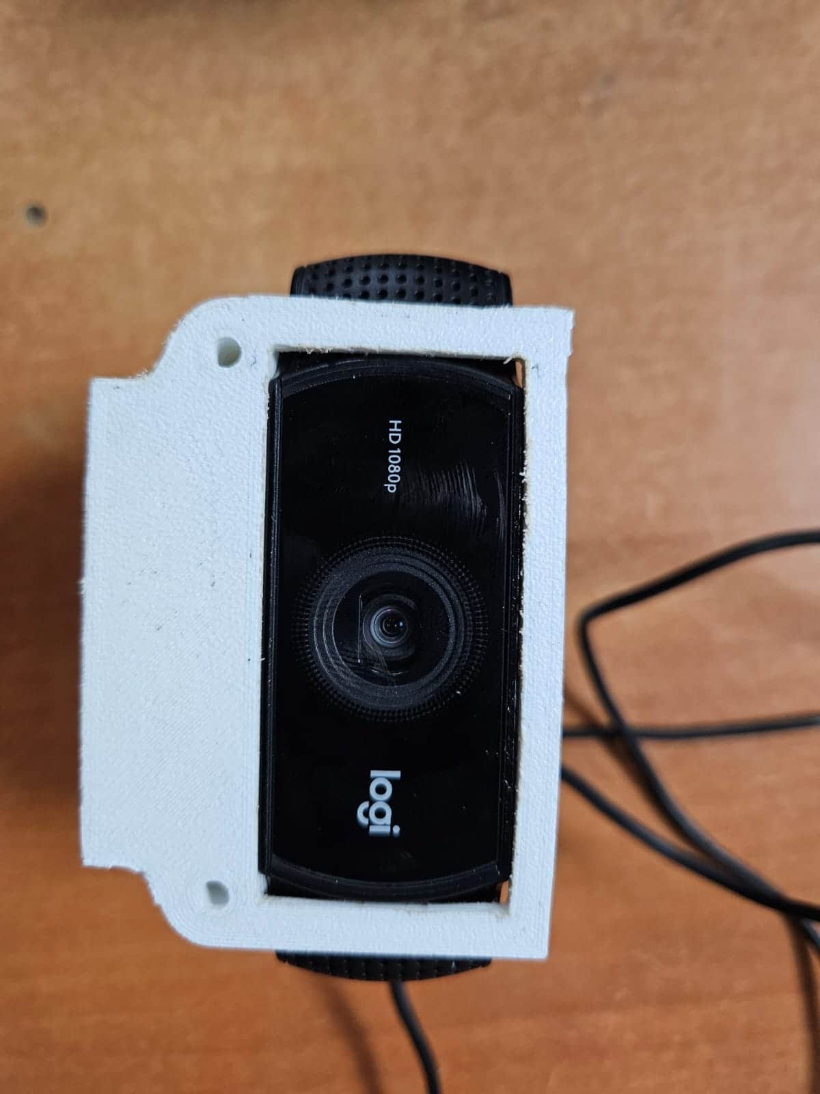

Slide 19
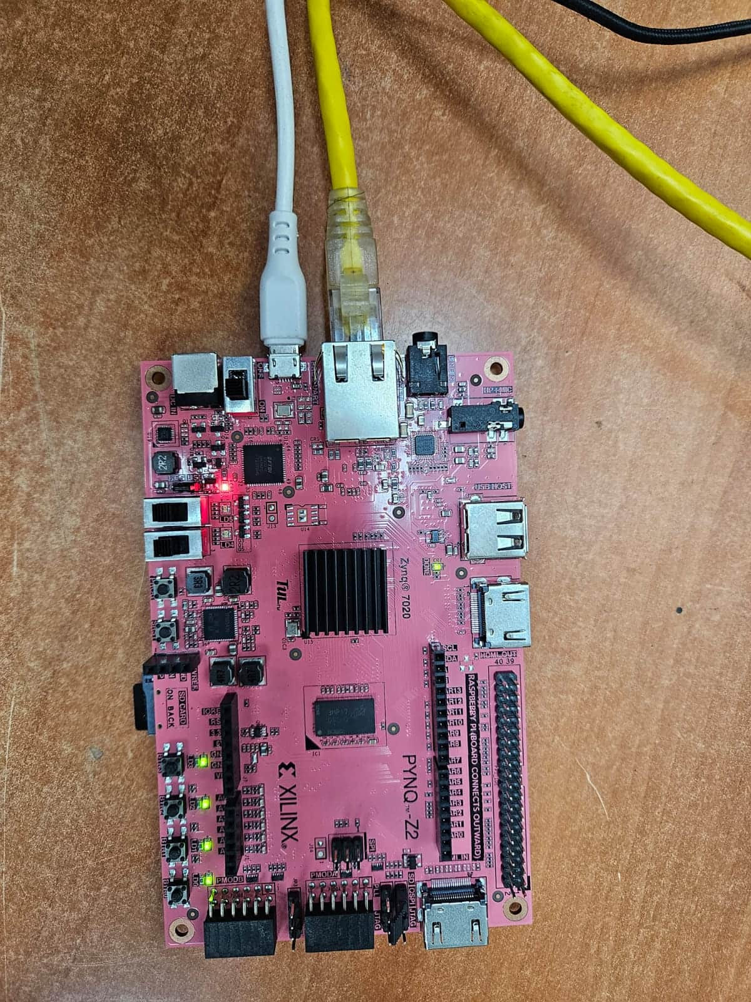
PYNQ BOARD

Slide 20
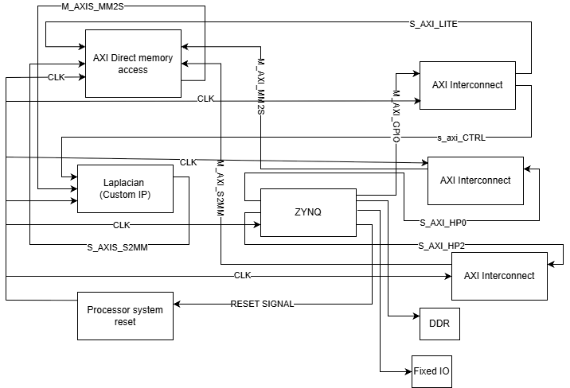
Overlay Block Diagram
21MHP401L/403L - Major Project

Slide 21
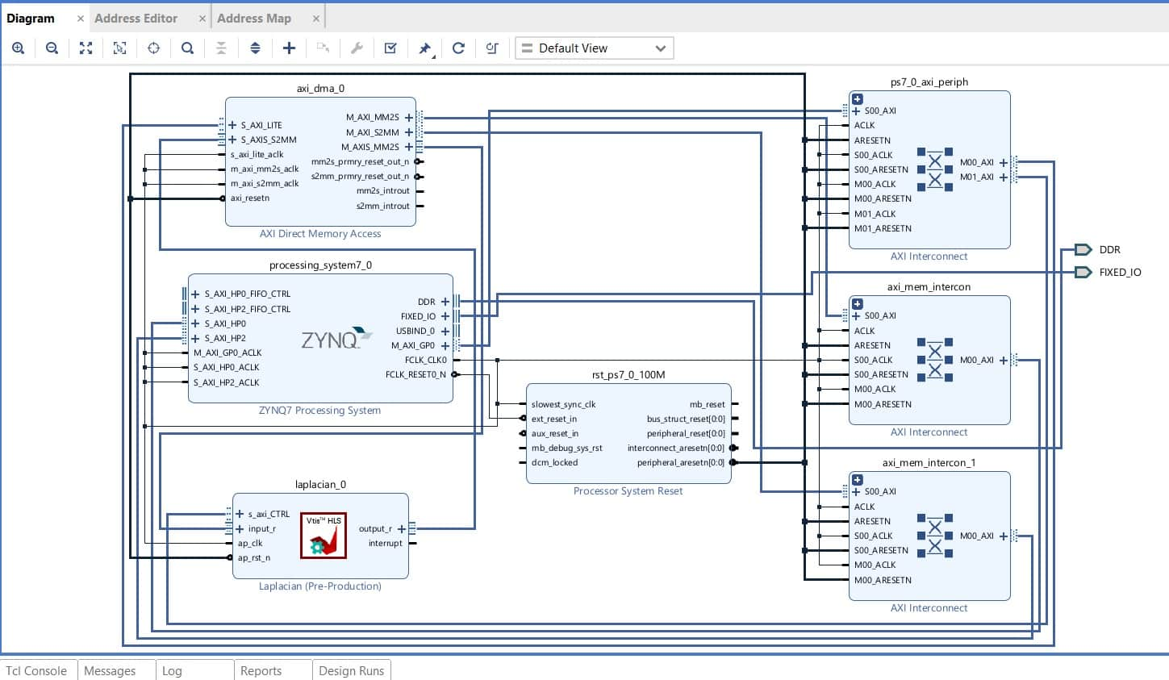
Progress after zeroth review

Slide 22
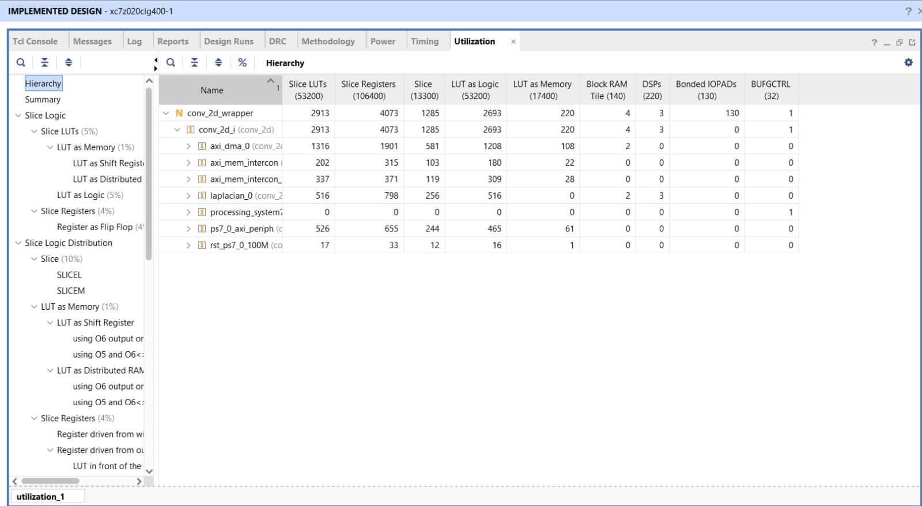
Progress after zeroth review

Slide 23
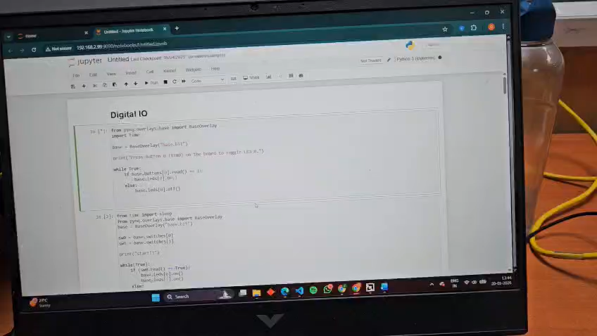
Digital IO Interfacing

Slide 24
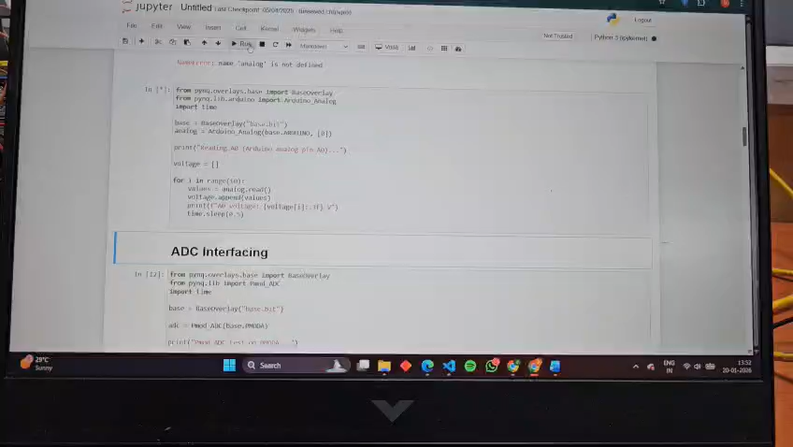
Analog IO interfacing

Slide 25
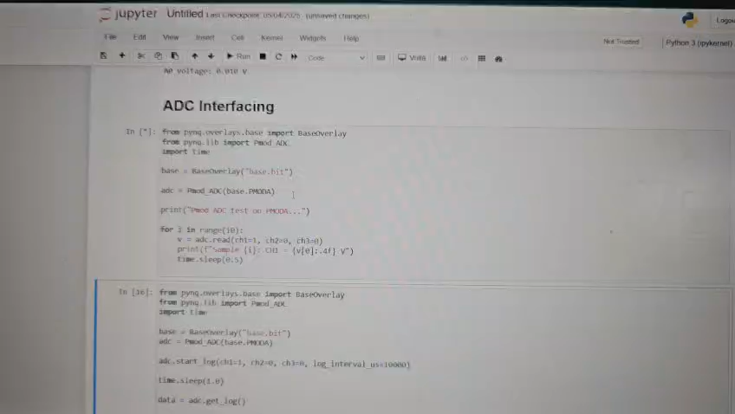
ADC Interfacing

Slide 26
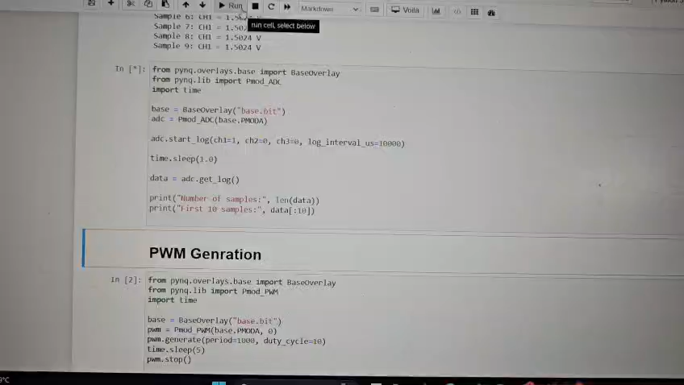

Slide 27
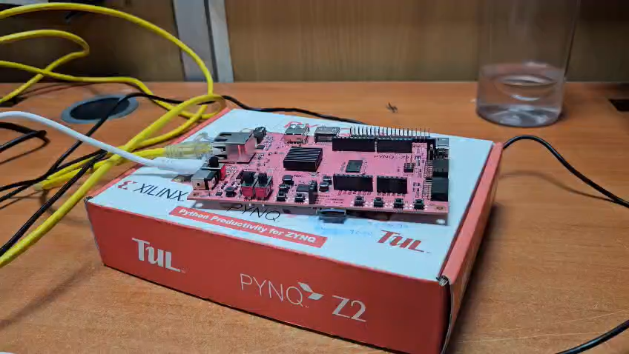
PS (ARM processor) Benchmark

Slide 28
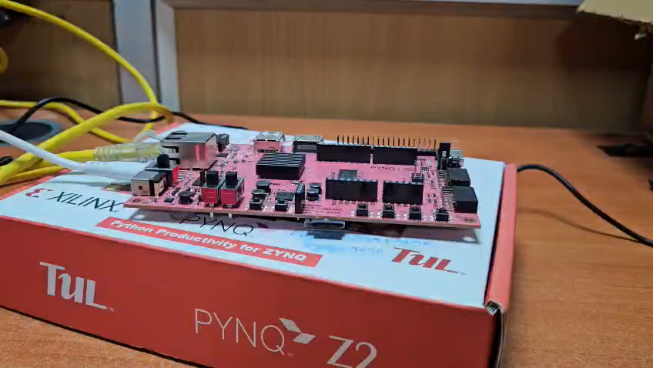
PL (FPGA) Benchmark

Slide 29
Work split up among the members (in accordance with the work progress after the zeroth review)
S.No | Member Name | Work allocated and/or completed
1. | Sharish K A | Simulating Resolver circuit and implementing control to stabilise rotor against external disturbance and to tracking of external reference.
2. | Diyanez Kandasaamy J S | PYNQ interfacing, Digital and analog IO interfacing(FPGA), Custom IP generation using VITIS HLS, Integrating the custom IP using VIVADO, PS and PL Benchmark.
3. | Anirudh A | CAD modelling, Literature survey, electronics and hardware procurement.

Slide 30
References
K. -j. Seong, H. -g. Kang, B. -y. Yeo and H. -p. Lee, "The Stabilization Loop Design for a Two-Axis Gimbal System Using LQG/LTR Controller," 2006 SICE-ICASE International Joint Conference, Busan, Korea (South), 2006, pp. 755-759, doi: 10.1109/SICE.2006.315268.
D. -H. Nguyen and V. -H. Nguyen, "Robust Control of Two-Axis Gimbal System," 2019 International Symposium on Electrical and Electronics Engineering (ISEE), Ho Chi Minh City, Vietnam, 2019, pp. 177-182, doi: 10.1109/ISEE2.2019.8921070.
A. Kriouile, S. Hamida, O. El Gannour and A. Latif Abdou Moussa, "Real-Time Adaptive Target Tracking via Inverse Kinematics Optimization in Stabilized Systems," in IEEE Access, vol. 13, pp. 145977-145995, 2025, doi: 10.1109/ACCESS.2025.3600197.
Cahyono, Dimas & Habibi, Anang & Fairuziya, Aina & Caesarendra, Wahyu. (2025). Design and Implementation of a PID Controller for a Two-Axis Gimbal System Using ESP32. International Journal of Artificial Intelligence & Robotics (IJAIR). 7. 72-82. 10.25139/ijair.v7i2.10771.
H. P. Lee, "Robust Control of a Two-Axis Gimbaled Seeker Using Loop Shaping Design Procedure," 2019 20th International Carpathian Control Conference (ICCC), Krakow-Wieliczka, Poland, 2019, pp. 1-6, doi: 10.1109/CarpathianCC.2019.8766056.
Huang, Q., Zhou, J., Chen, X., Yao, Y., Chen, Y., Chen, W., Chen, R., & Lv, Z. (2024). Modeling and Control of a Two-Axis Stabilized Gimbal Based on Kane Method. Sensors, 24(11), 3615. https://doi.org/10.3390/s24113615

Slide 31
References for PYNQ
https://discuss.pynq.io/t/tutorial-creating-a-hardware-design-for-pynq/1452
https://discuss.pynq.io/t/tutorial-pynq-dma-part-1-hardware-design/31333.
https://discuss.pynq.io/t/tutorial-pynq-dma-part-2-using-the-dma-from-pynq/31344.
https://discuss.pynq.io/t/tutorial-using-a-hls-stream-ip-with-dma-part-1-hls-design/33445.
https://discuss.pynq.io/t/tutorial-using-a-hls-stream-ip-with-dma-part-2-vivado-design/3345

Slide 32
Thank You

